Slide 1

One Last Zoom!
Bob Harris, CAE
www.nonprofitcenter.com

Slide 2
Discussions
Pandemic Rebound - “Victory Tour”
Board Refresh
Strategic Update (G.P.S.)

Slide 3
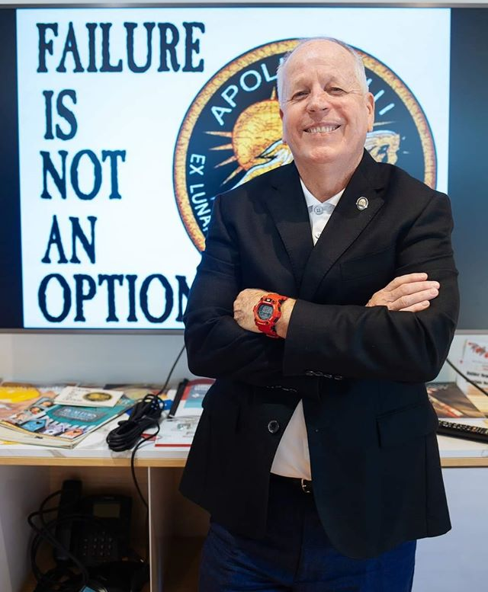


What about Bob
Florida
CAE – ASAE
US Chamber – IOM
Ukraine, Myanmar, Belarus, Lebanon. etc.
www.nonprofitcenter.com
bob@rchcae.com

Slide 4
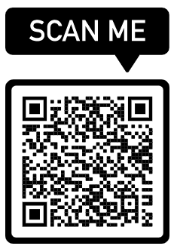
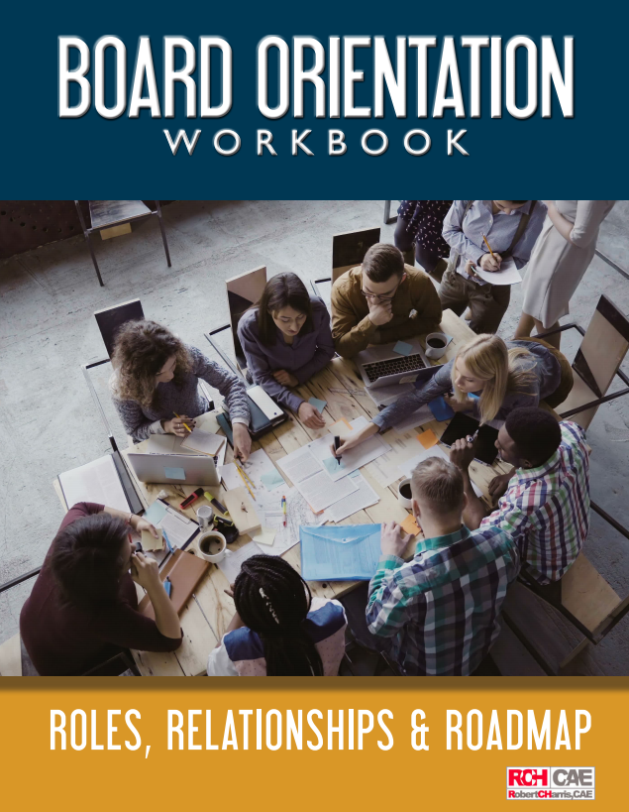
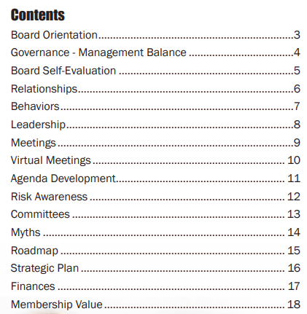
Free Resources – www.nonprofitcenter.com
20-Page Board Workbook
https://www.dropbox.com/s/gzswr7r1w87acb8/Board%20Orientation%20Workbook%202021%20Final.pdf?dl=0

Slide 5
Pandemic
Rebound

Slide 6
Pandemic Rebound
Be the “Indispensable Partner”
Members with Short Memories
Tell them What You’ve Done
Communicate Value
Demonstrate Leadership

Slide 7
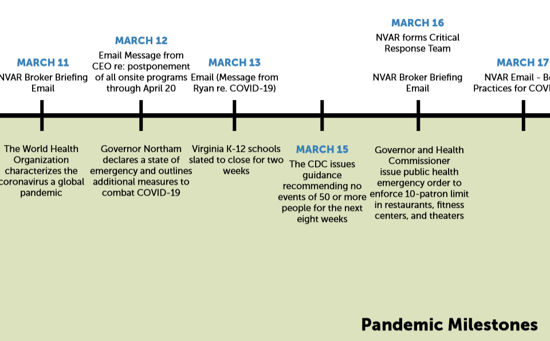
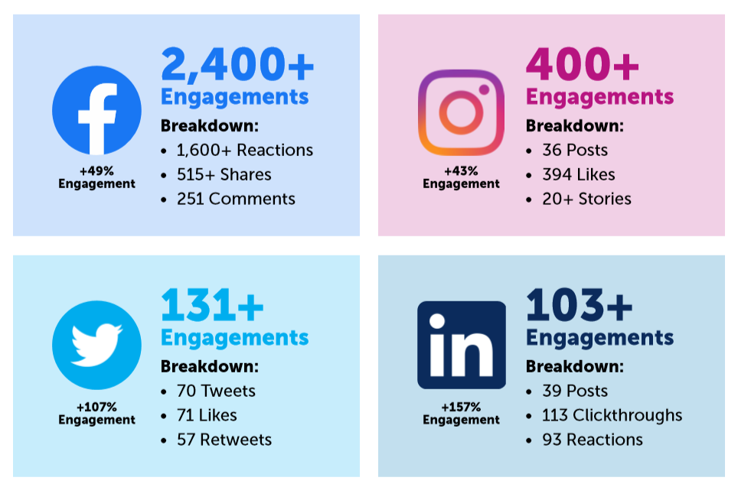
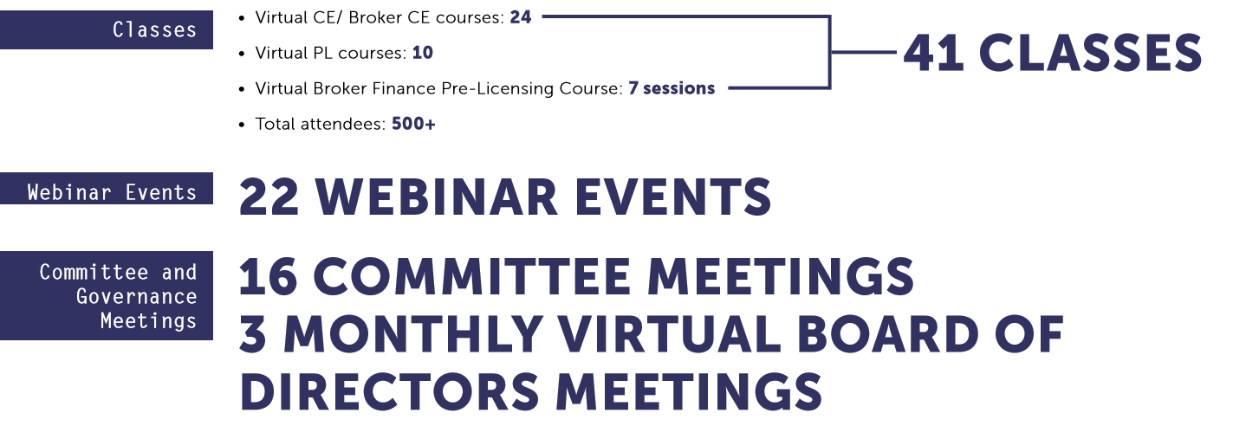
Pandemic Response and Timeline
Dashboard
Timeline
Impact Report

Slide 8
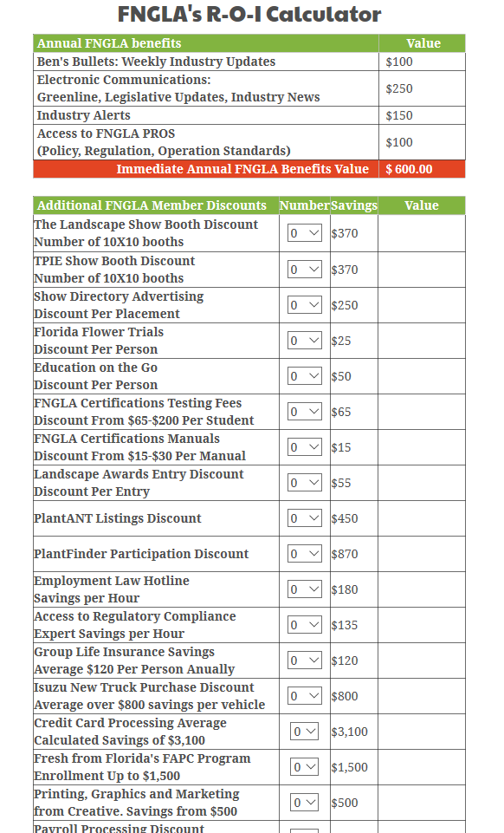
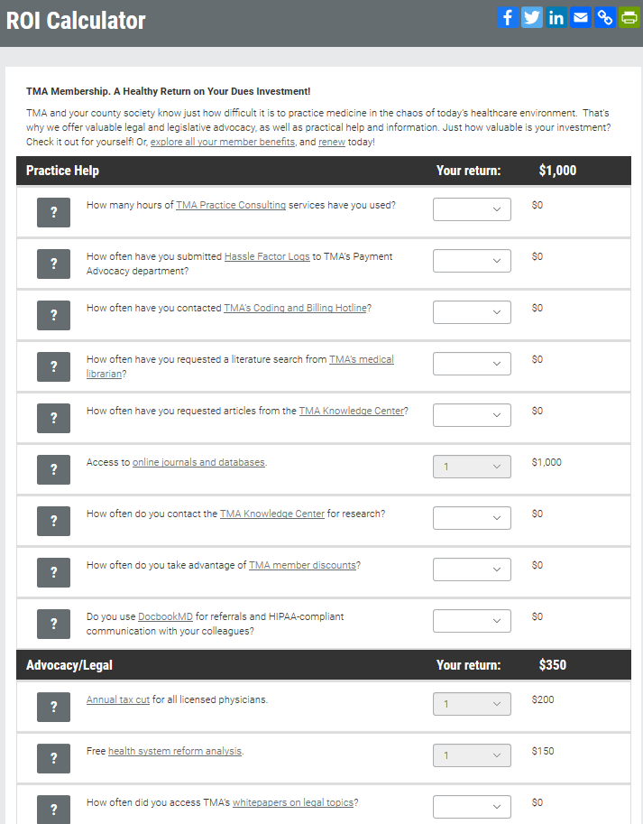
Communicate VALUE and ROI
fngla.org/membership/roi
ROI Value Calculator

Slide 9
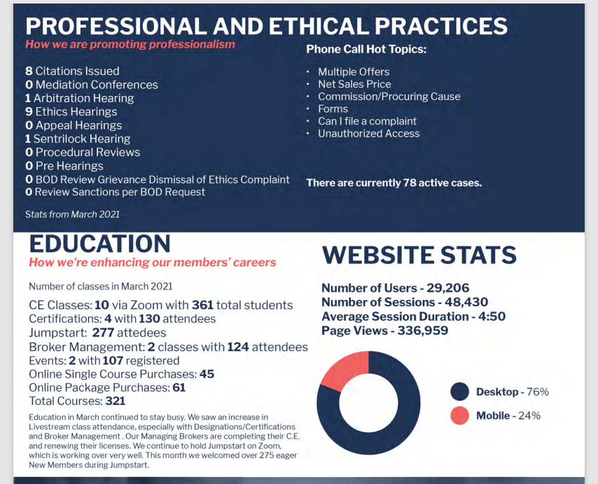
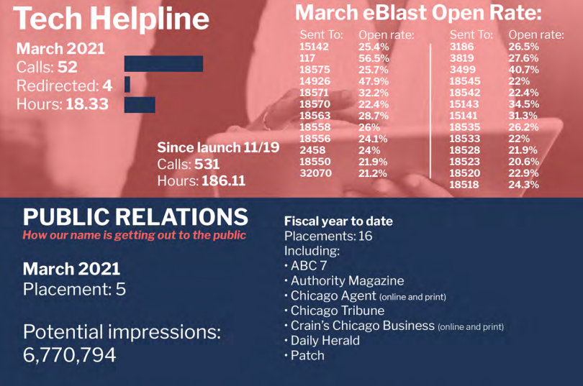
Dashboard

Slide 10
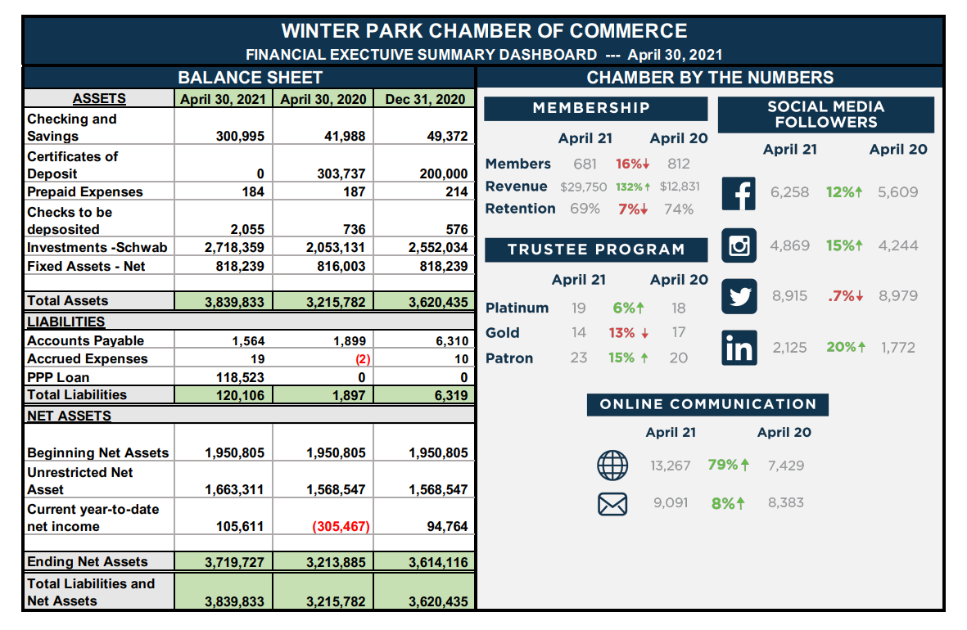
Performance Dashboard

Slide 11
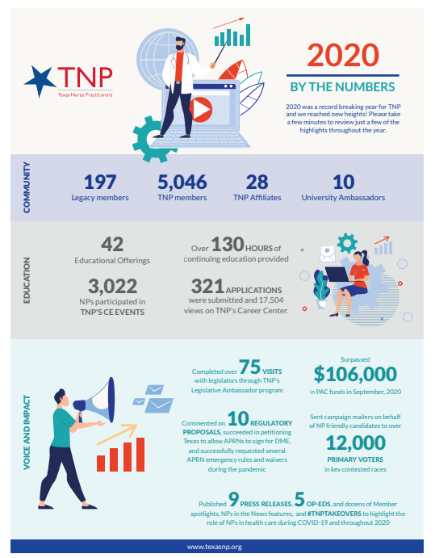
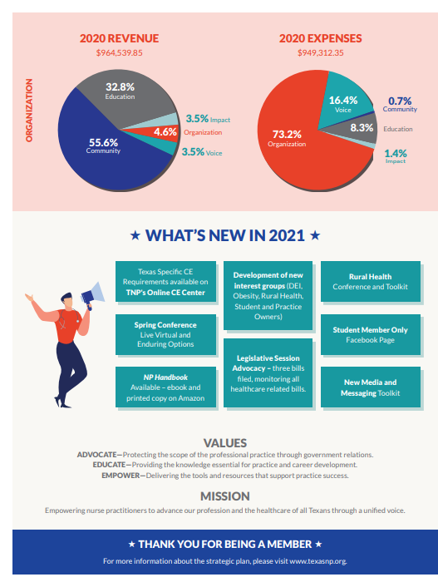
Info Graphic
Communicate Strength
Economic Impact
Easy to Read/Visualize
Website/Billing Notices/Meetings

Slide 12
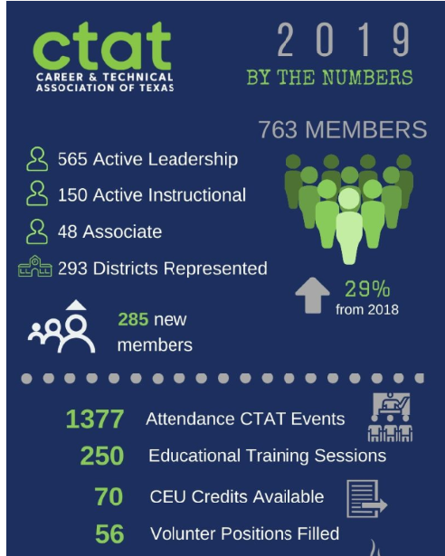
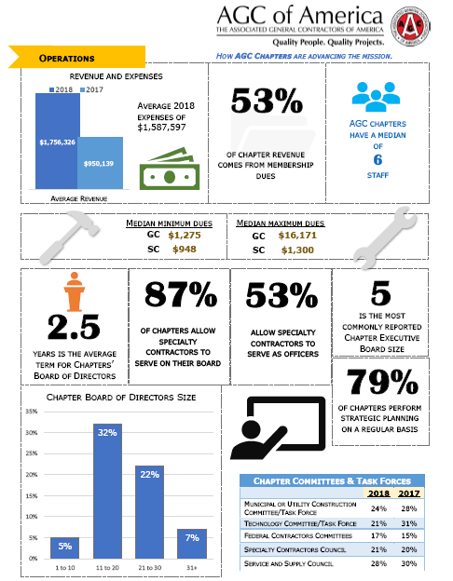
Info-Graphics

Slide 13

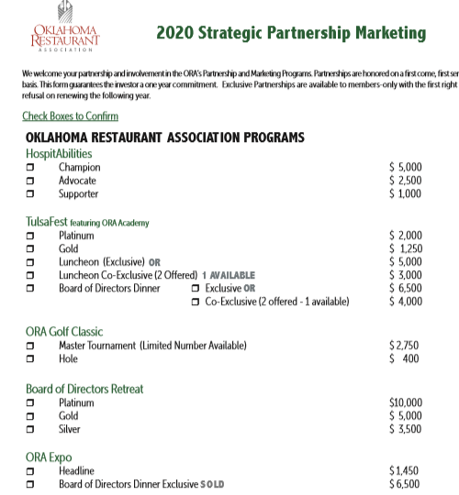
Sponsor Opportunity Menu

Slide 14

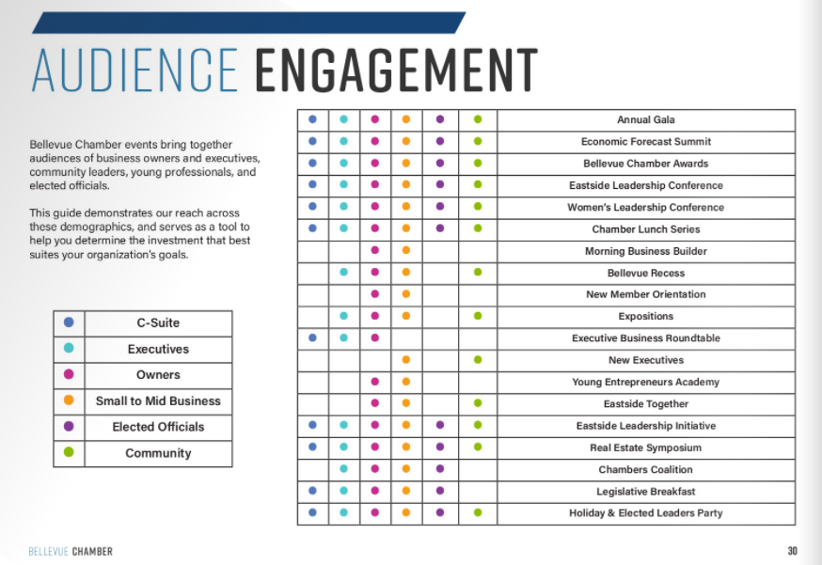
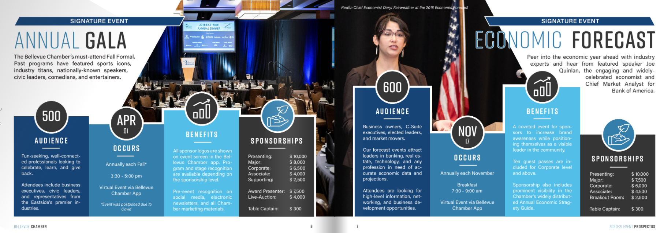
Sponsor
Opportunity Menu

Slide 15
Board
Refresh

Slide 16

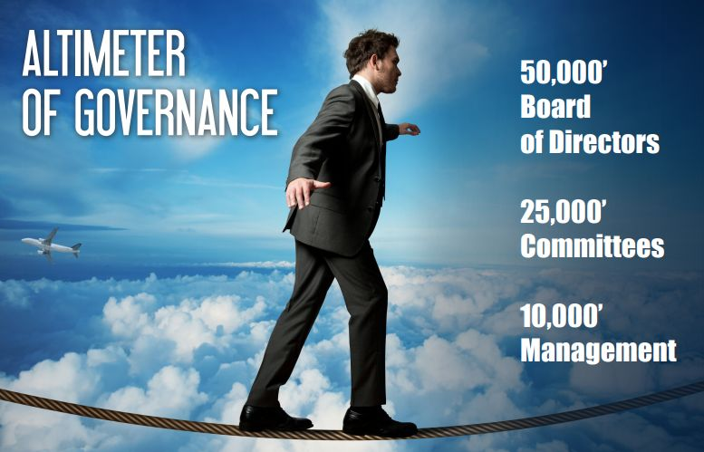

Slide 17
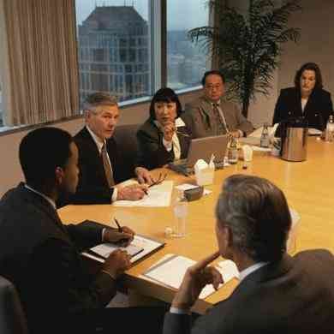
Will you serve on our board?

Slide 18
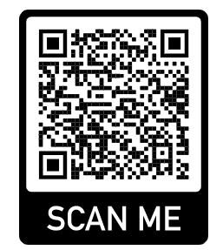
Describing Board Protections
Directors and Officers (D&O)
Incorporated
Indemnification
Volunteer Immunity (gov. docs)

Slide 19
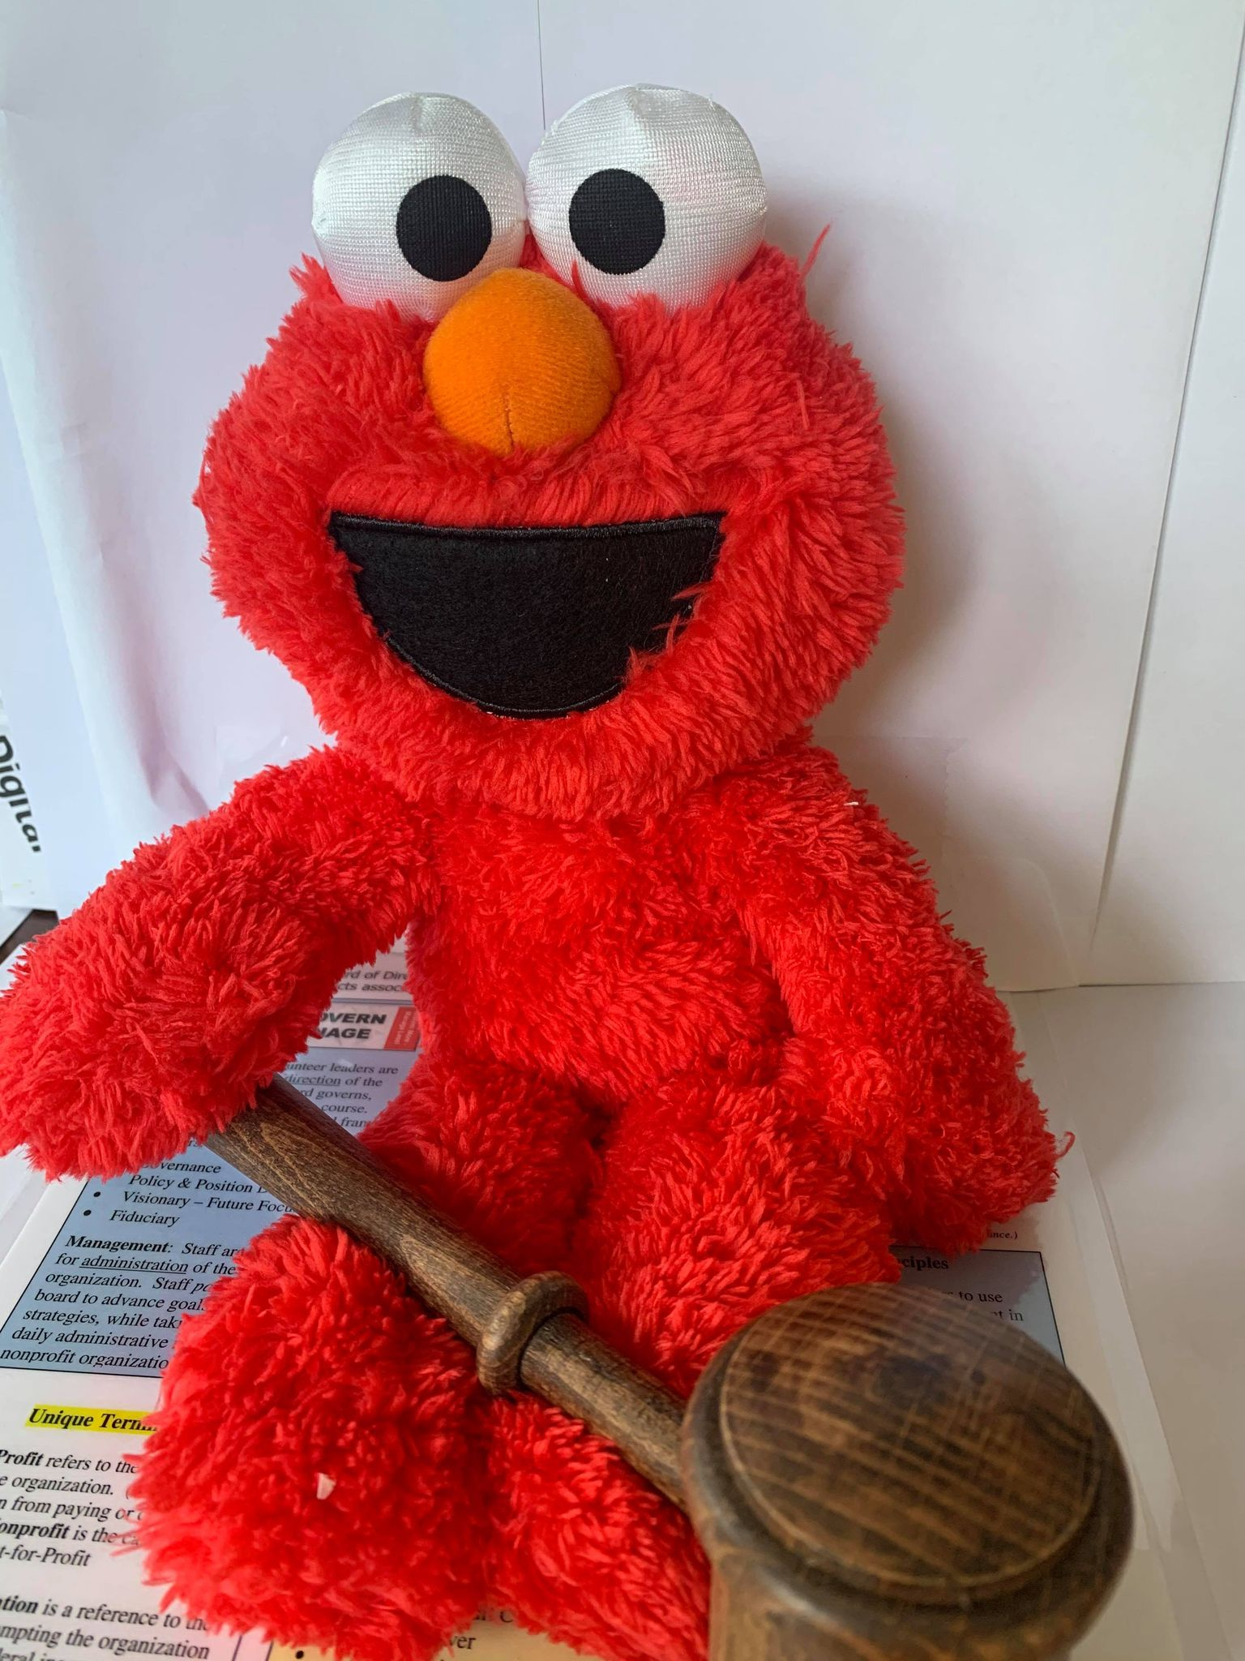
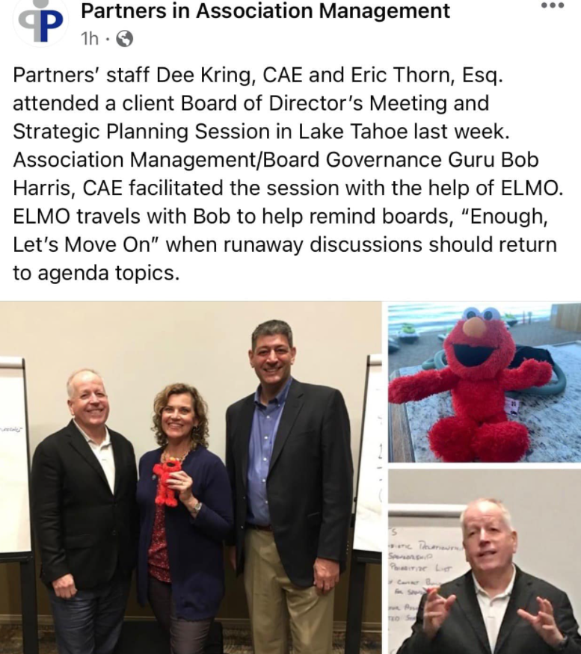
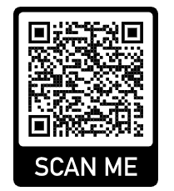
ELMO
Enough, let’s move on.

Slide 20


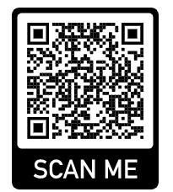
Analysis Paralysis

Slide 21

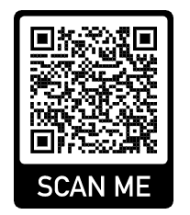
Organization Principles/Guiding Values
Diversity - DEI
  IDEA - Inclusion, Diversity, Equity & Action
Accountability
Transparency
Integrity
Strategic
Innovative
Fund Raising

Slide 22
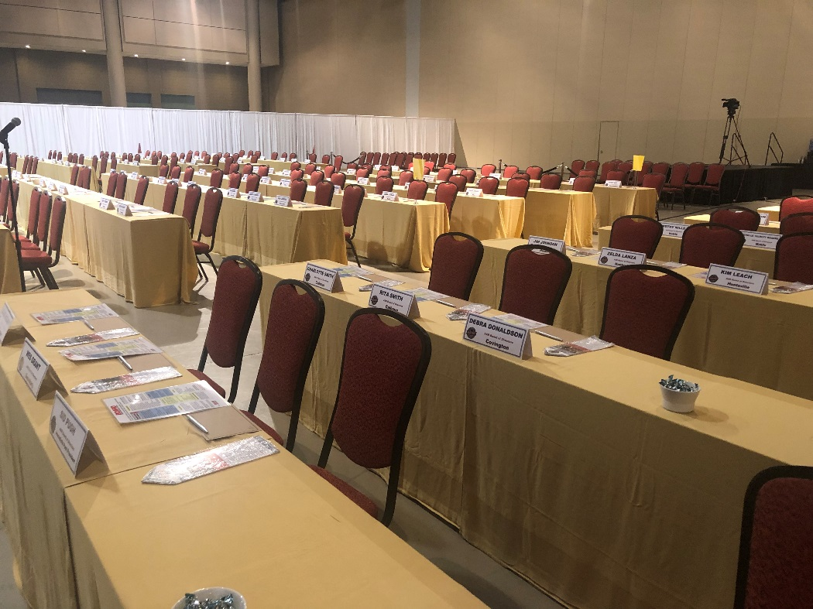
Board Size and Frequency

Slide 23

Director Roles
Trustee
  Protect the organization, avoid risk, set the vision
  Legal entity, rely on your legal counsel
Fiduciary
  Represent the interests of stakeholders, users
  Avoid conflicts of interest

Slide 24
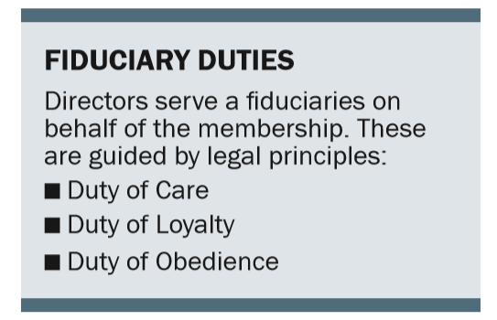
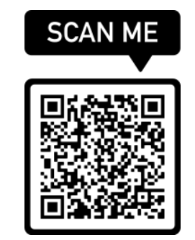

Slide 25
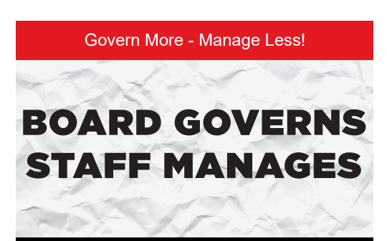
The Partnership

Slide 26

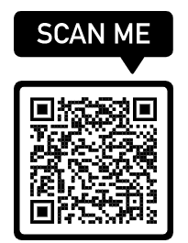
Commitment Form
Read and uphold the governing documents.
Work to advance the mission; serve the members.
Respect confidentiality of discussions and documents.
Disclose conflicts of interest.
Avoid antitrust violations.
Support decisions of the board.

Slide 27
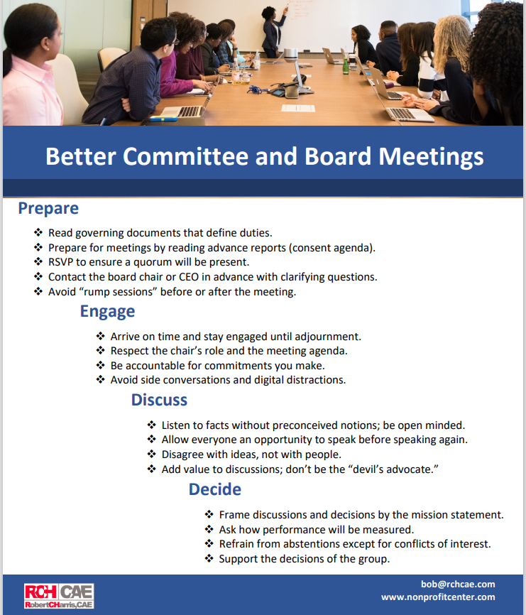
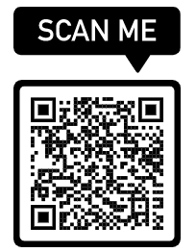

Slide 28
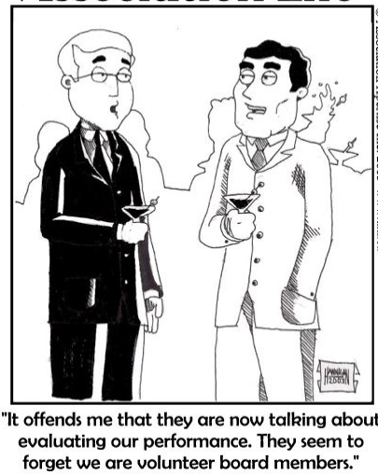
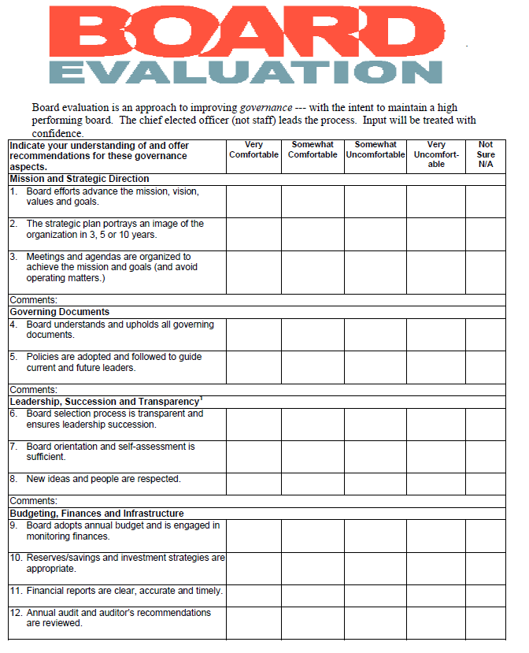
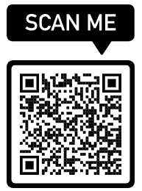
Board Self Evaluation

Slide 29
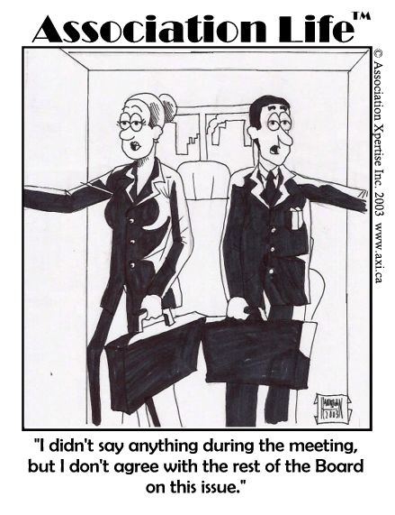
Support the decisions made at the meeting.

Slide 30
Committees

Slide 31
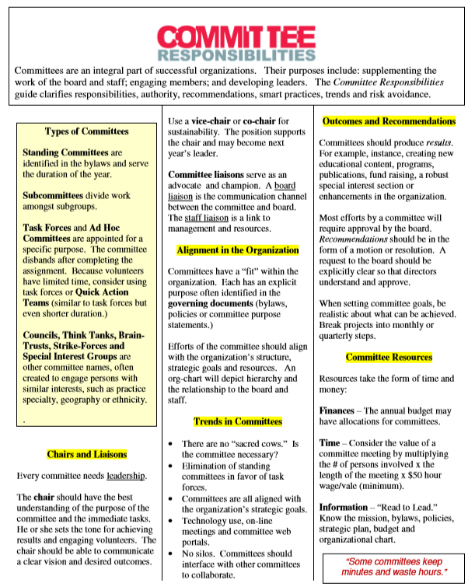
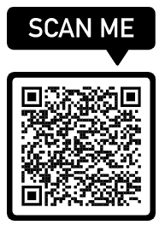
Supplement work of board and staff.
Aligned with strategic plan goals.
Asset or Liability
Keep meeting records/minutes.
https://www.dropbox.com/s/c28s6fz0t4gw19x/Committee%20Responsibilities%202%20pg%20Guide%202019-20%20%282%29.pdf?dl=0

Slide 32

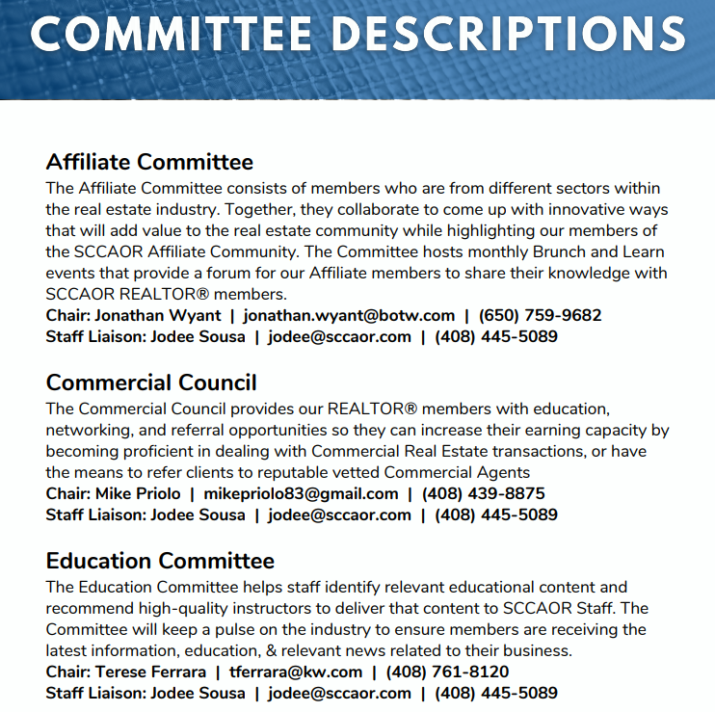
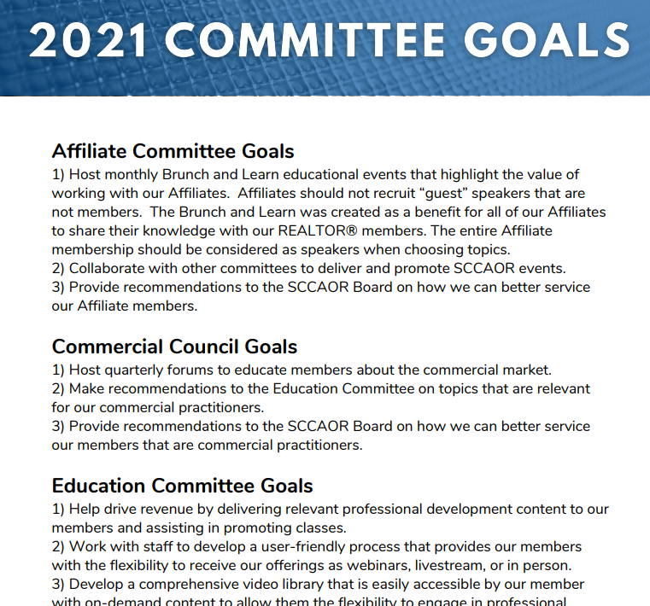
Committee Management

Slide 33
Strategic
Direction

Slide 34

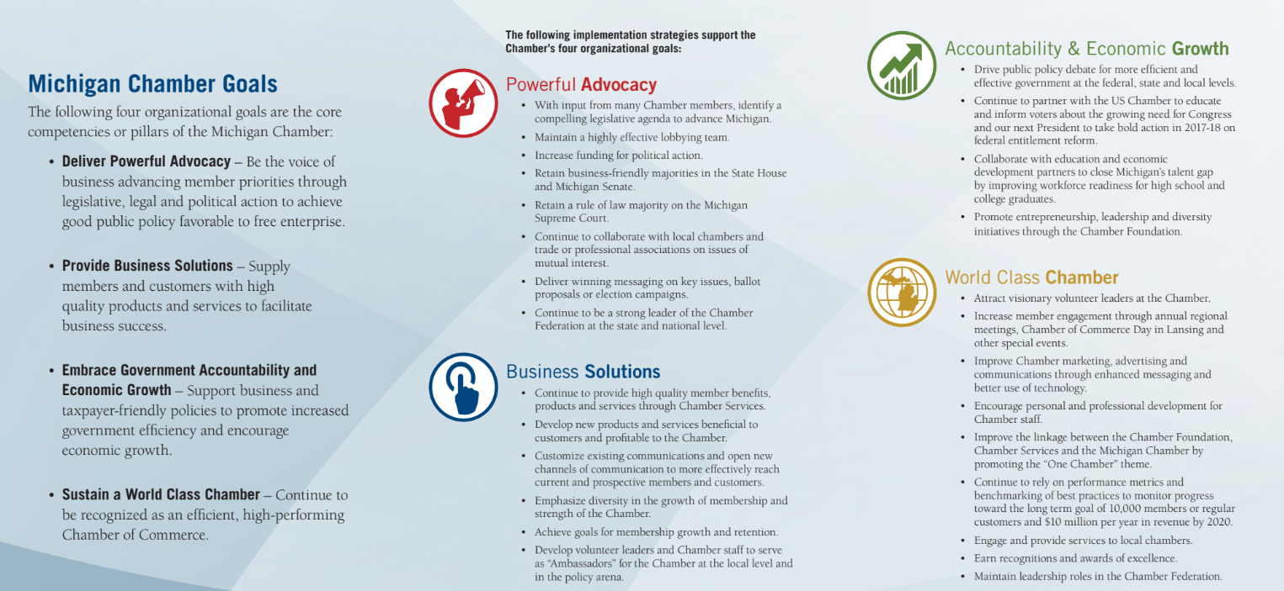
Member Brochure

Slide 35
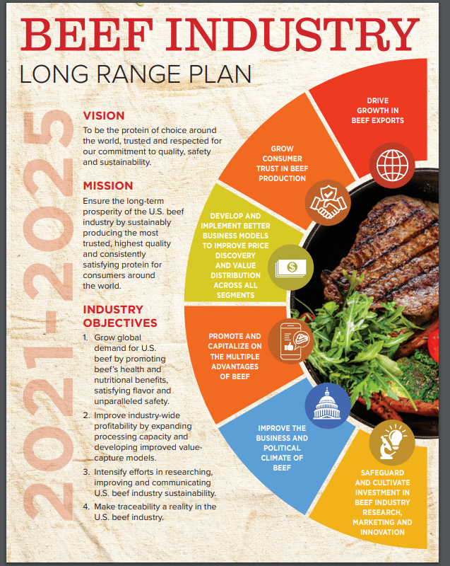
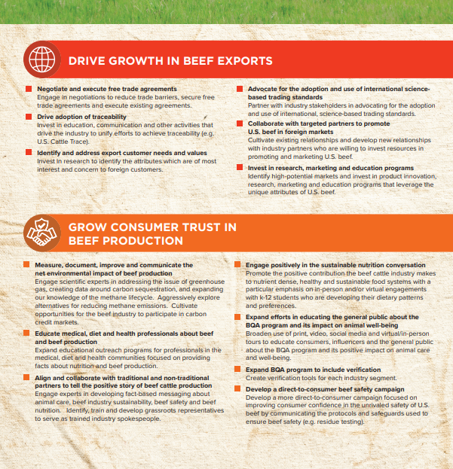
PDF

Slide 36
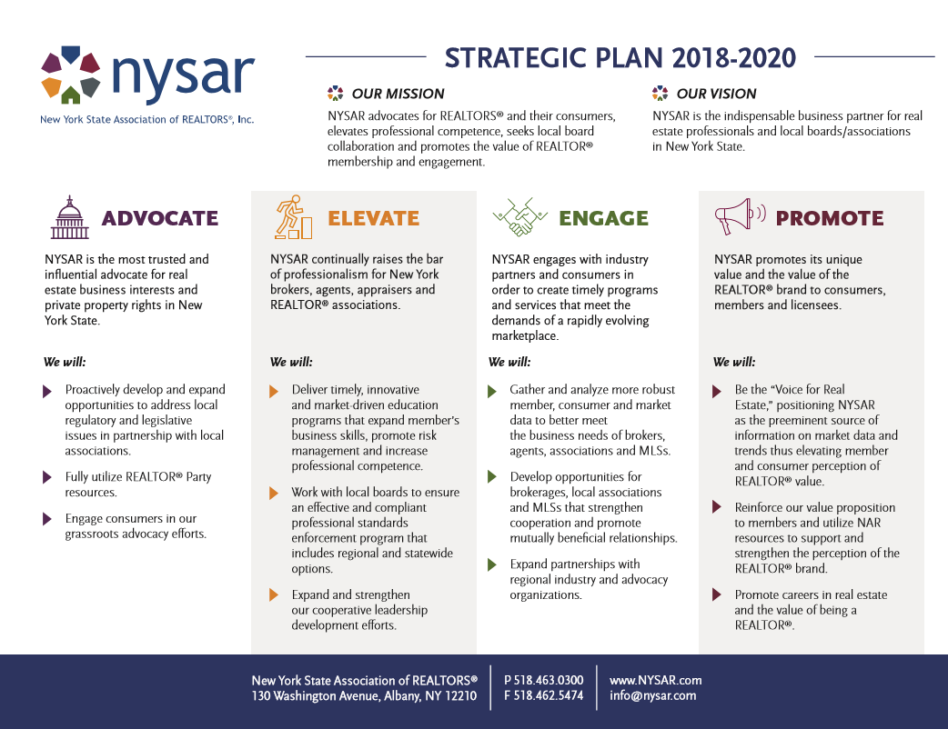
Placemat Format

Slide 37
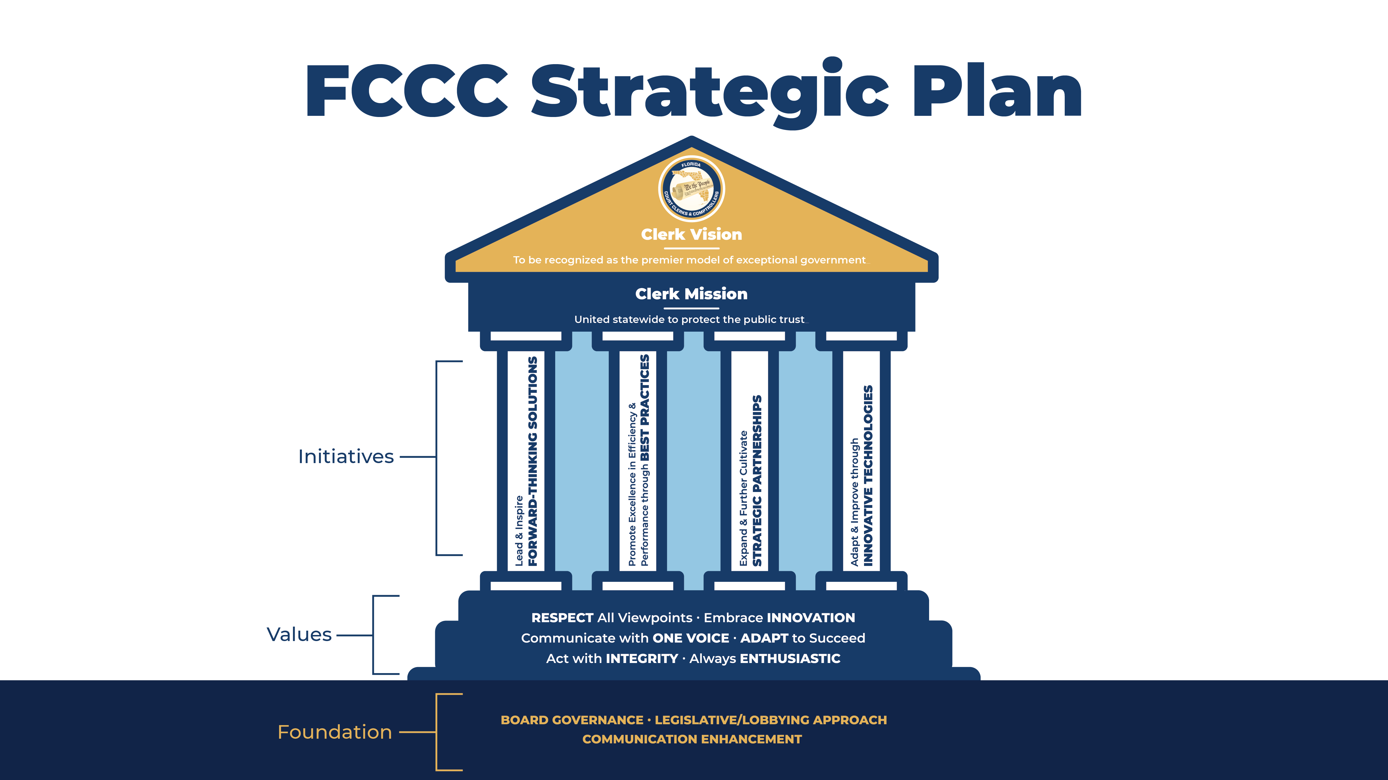

Parthenon Model

Slide 38
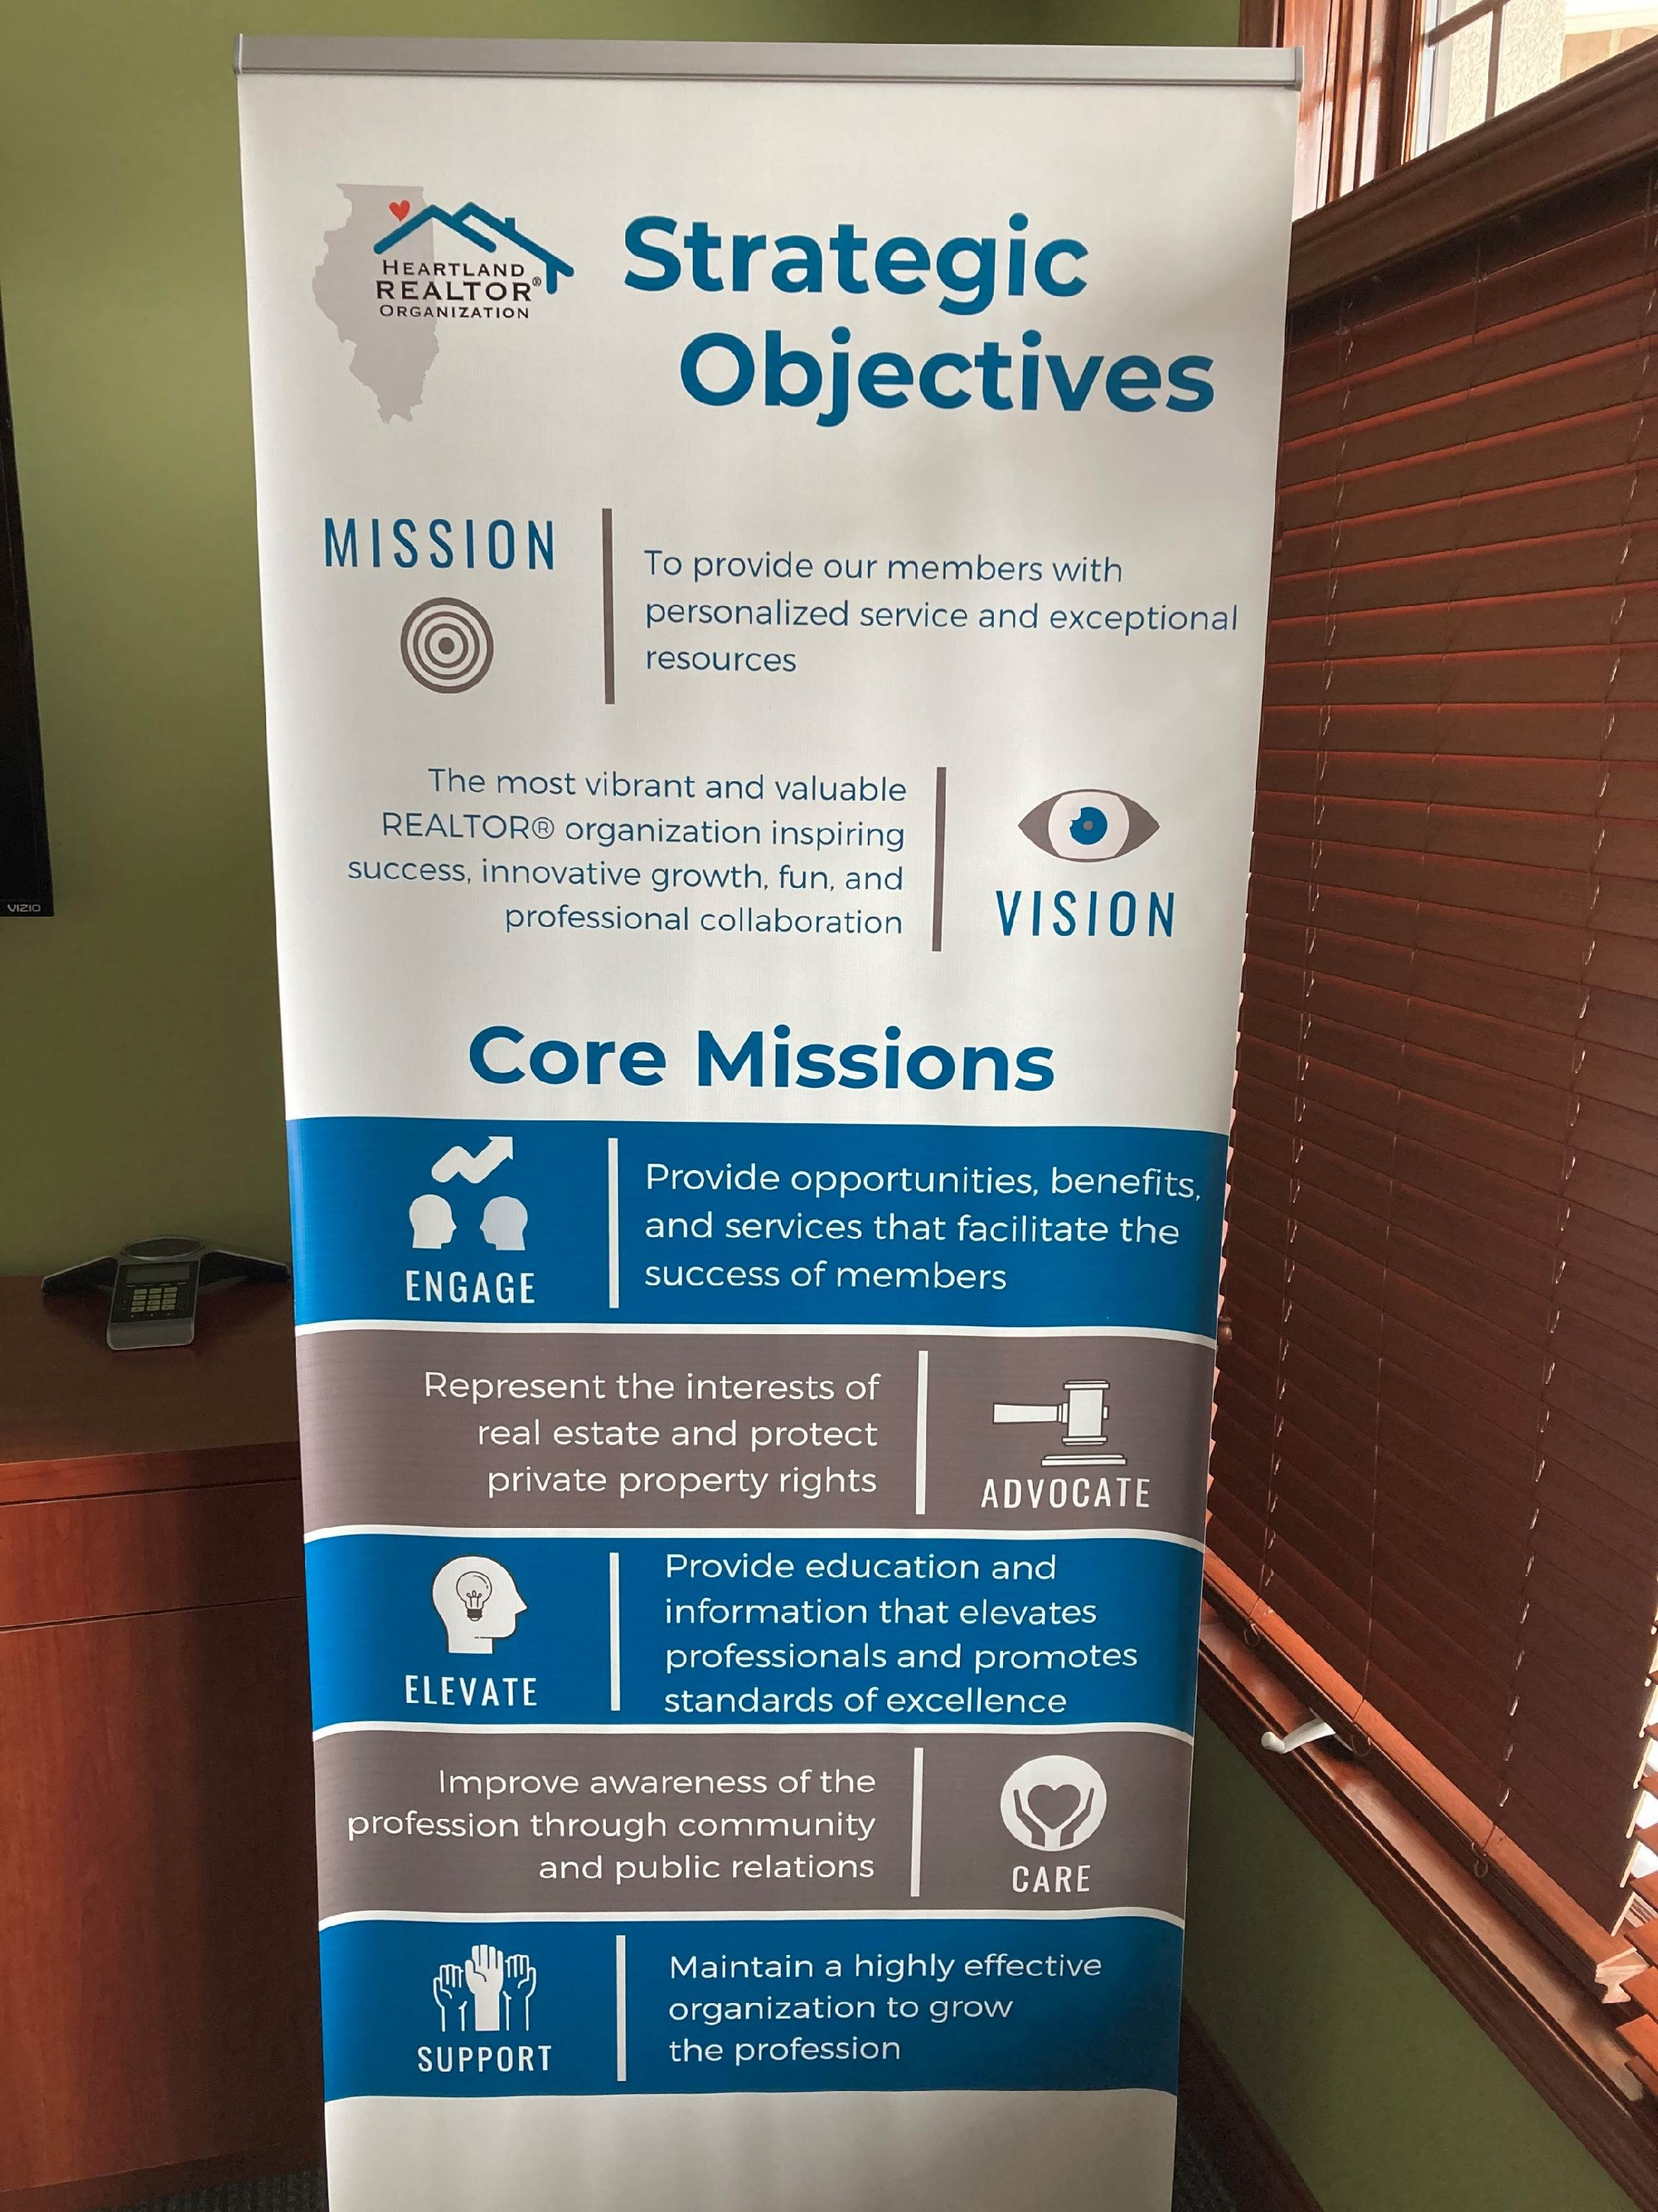
Meetings’ Banner

Slide 39
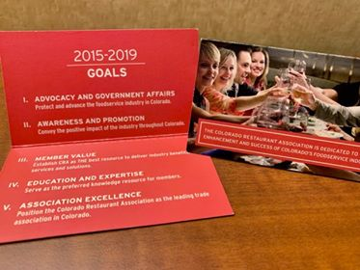
Business Card

Slide 40
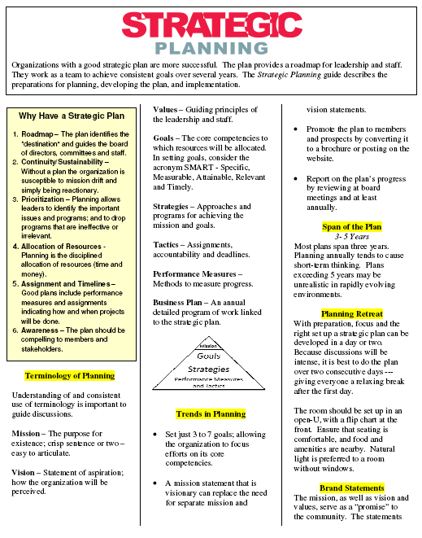

Strategic Plan
Roadmap for Leadership
Communicate Value to Membership
Aligns Committees and $
Empowers the Staff

Slide 41

Victory Tour – One Last Zoom ☺

Slide 42




